Slide 1
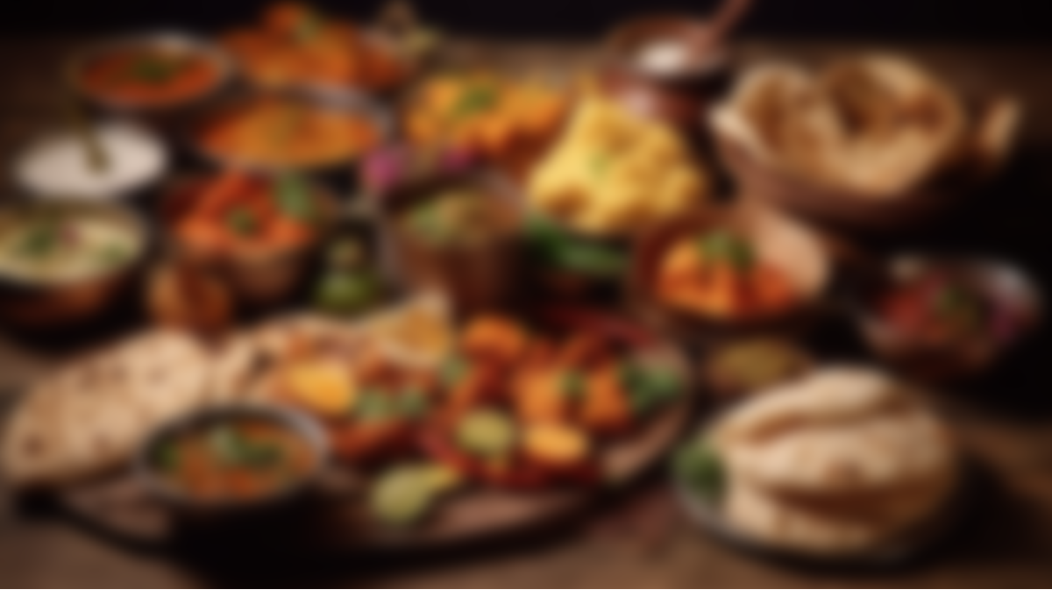

RecipeLens
Recipe from image
ASANSOL ENGINEERING COLLEGE
Guided by : Mr. Sudip Kumar De
Presented By
Biplab Gorain (10800221149)
Sheela Bhattacharjee (10800220066)
Bishnu Sharma (10800220065)
Projjal Mitra (10800220059)
Department of Information Technology

Slide 2
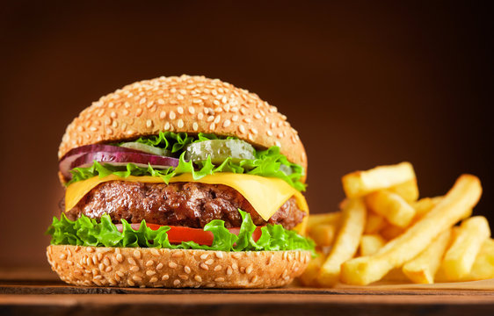
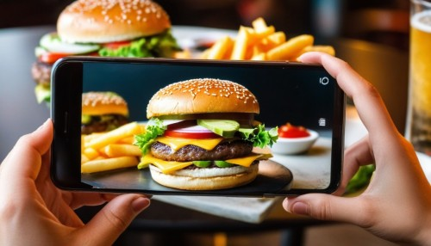
What is RecipeLens?
RecipeLens, from the name itself, we can guess that it’s something related to recipes. But what is the meaning of 'lens' here?
So, RecipeLens is a type of Google Lens. Just as Google Lens helps us find many things from the web by taking images of them, RecipeLens also finds recipes by simply taking images of foods.

Slide 3
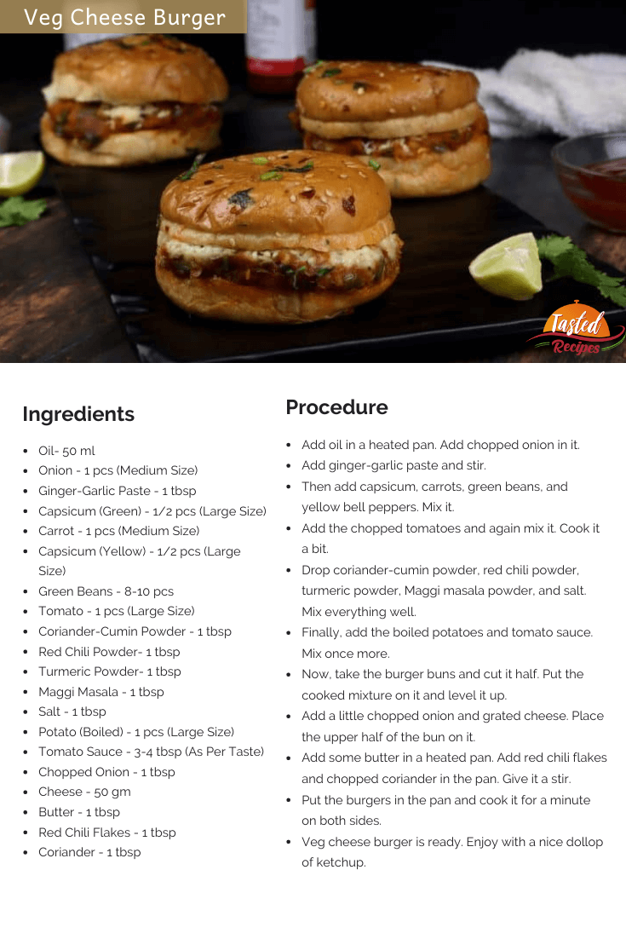
What is RecipeLens?
RecipeLens, from the name itself, we can guess that it’s something related to recipes. But what is the meaning of 'lens' here?
So, RecipeLens is a type of Google Lens. Just as Google Lens helps us find many things from the web by taking images of them, RecipeLens also finds recipes by simply taking images of foods.

Slide 4
What is RecipeLens?
RecipeLens, from the name itself, we can guess that it’s something related to recipes. But what is the meaning of 'lens' here?
So, RecipeLens is a type of Google Lens. Just as Google Lens helps us find many things from the web by taking images of them, RecipeLens also finds recipes by simply taking images of foods.

Slide 5
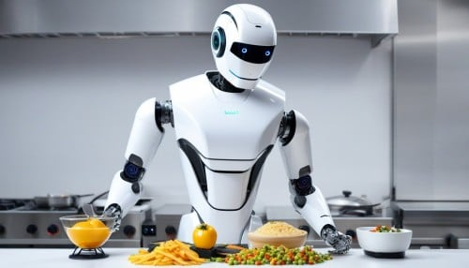
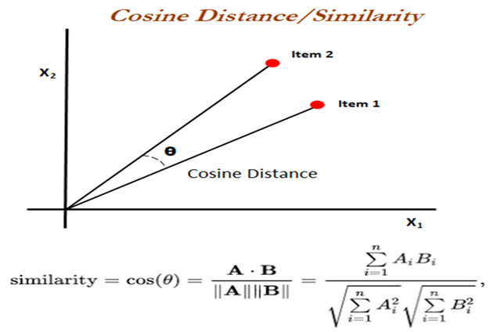
How recipelens work?
  The working principal of RecipeLens is given bellow –
  Mainly it has three part…
  Part 1 –
  Preprocessing of image

Slide 6
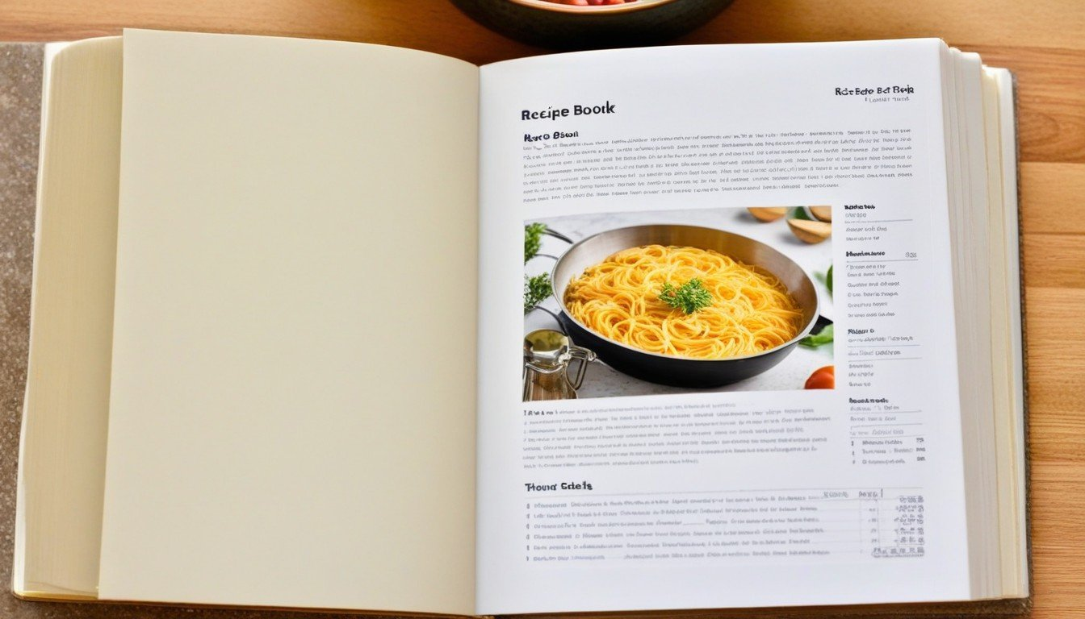
How recipelens work?
  The working principal of RecipeLens is given bellow –
  Mainly it has three part…
  Part 2 –
  Calculate similarity

Slide 7
How recipelens work?
  The working principal of RecipeLens is given bellow –
  Mainly it has three part…
  Part 3 –
  Retrieve the recipes.
  And he finally show the recipe to the user.

Slide 8
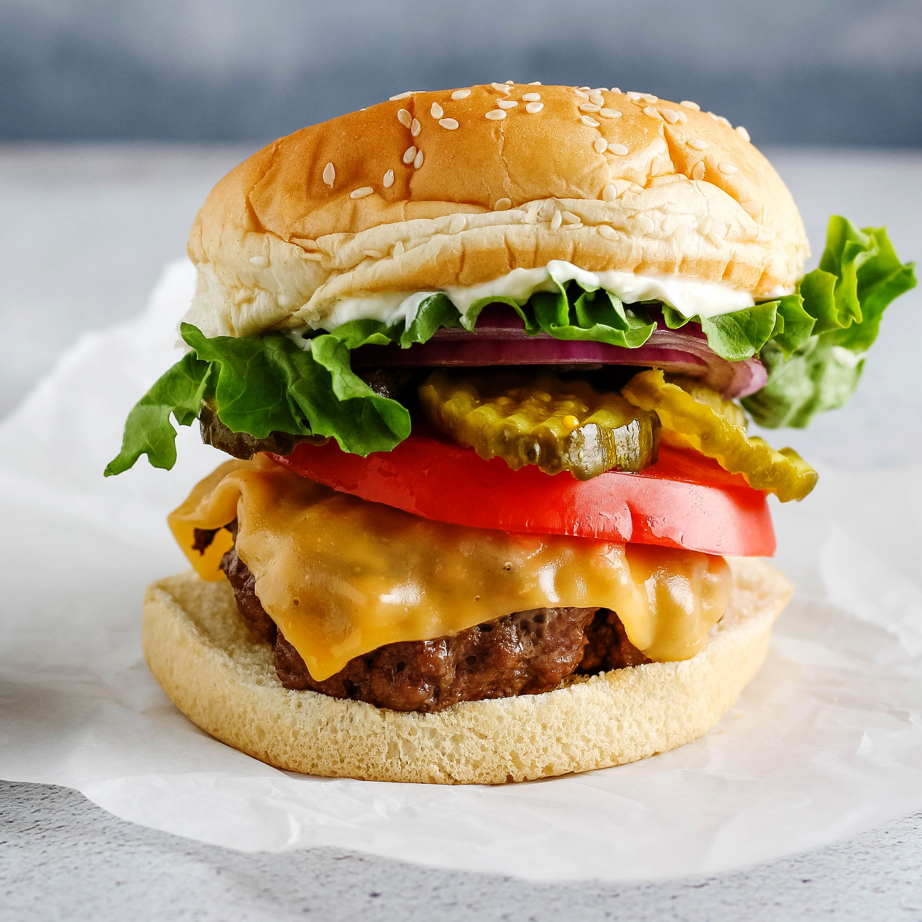
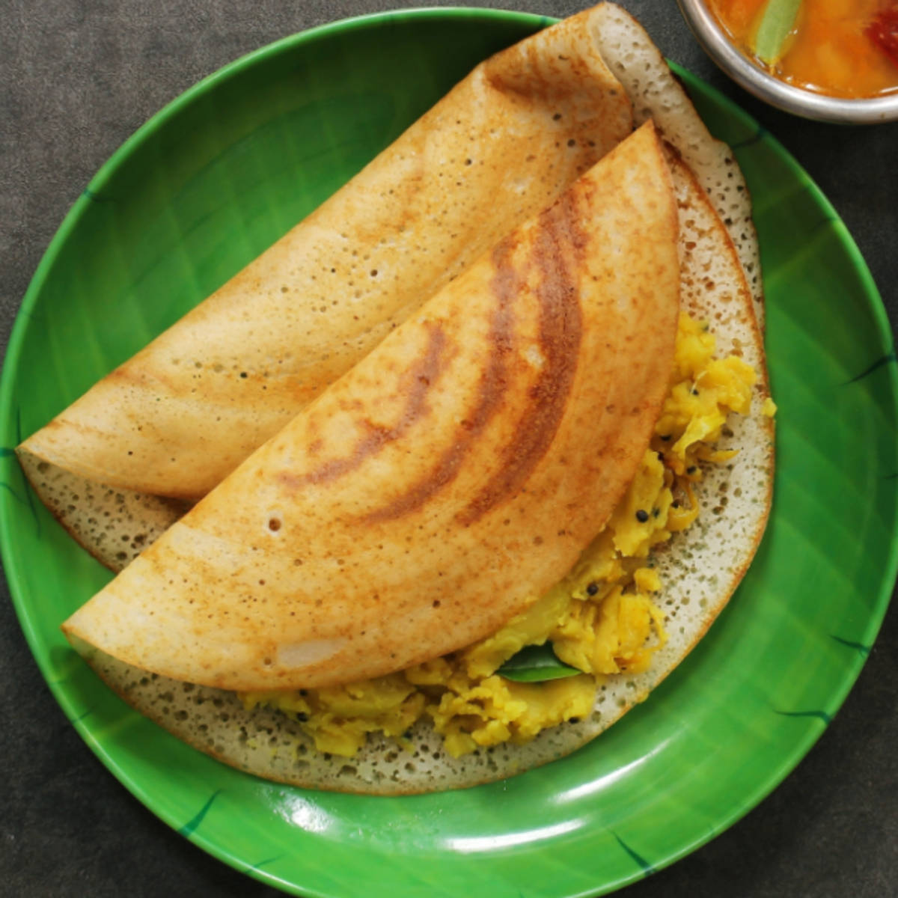
Part 1 : Preprocessing of image
The image that is being uploaded is converted into 1D array.
To convert the image into 1D array the pretrained model DenseNet201 is used .
Furthermore the 1D array is being sent for similarity check.
Dosa

Slide 9
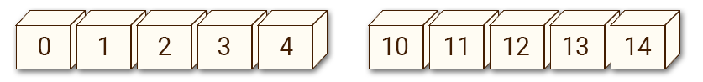
Part 1 : Preprocessing of image
The image that is being uploaded is converted into 1D array.
To convert the image into 1D array the pretrained model DenseNet201 is used .
Furthermore the 1D array is being sent for similarity check.
Dosa

Slide 10
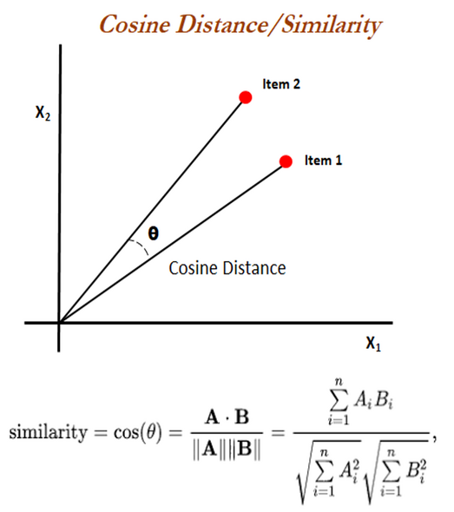
Part 2 : Calculate similarity
Calculate similarity using cosine distance between 1-D arrays from the already encoded foods.
All the most similar foods (less distance between them) is picked up for the result.
Dosa

Slide 11
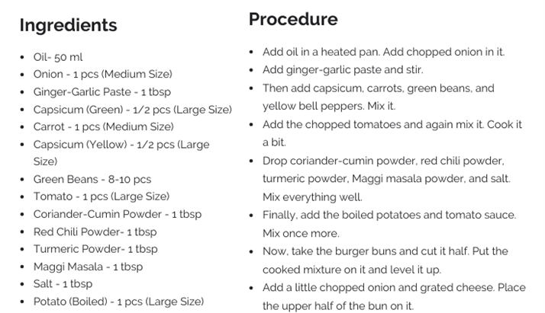
Part 3 : Retrieve the recipes
Get the recipes of all the picked foods from the database
Show the generated recipe along with the original image and cooking instructions on the web interface
Dosa

Slide 12
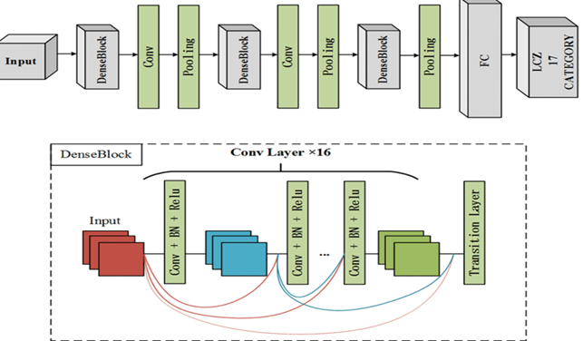
Model
Here the DenseNet201 architecture of keras TensorFlow, which is a pre-trained convolutional neural network (CNN) for image classification is used.
How DenseNet201 Works?
DenseNet201 is trained on large-scale datasets like ImageNet, making it capable of generalizing well to a variety of image recognition tasks. Its efficiency and accuracy make it particularly useful for applications on mobile devices, where computational resources may be limited.

Slide 13
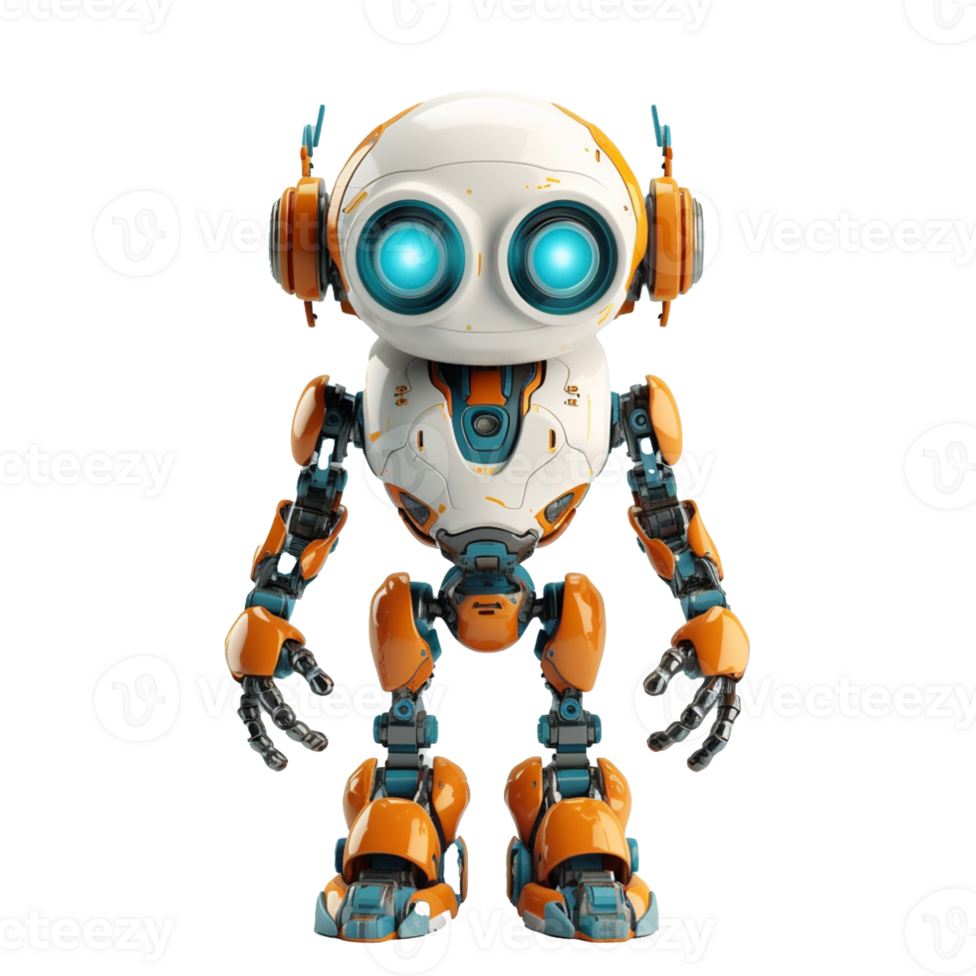
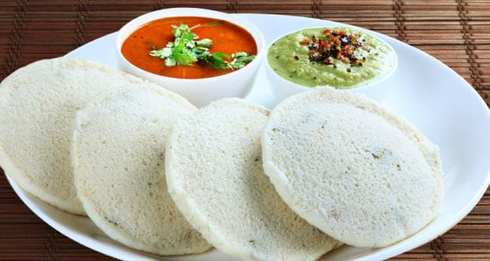
Model
Here the DenseNet201 architecture of keras TensorFlow, which is a pre-trained convolutional neural network (CNN) for image classification is used.
How DenseNet201 Works?
DenseNet201 is trained on large-scale datasets like ImageNet, making it capable of generalizing well to a variety of image recognition tasks. Its efficiency and accuracy make it particularly useful for applications on mobile devices, where computational resources may be limited.

Slide 14
Model
Here the DenseNet201 architecture of keras TensorFlow, which is a pre-trained convolutional neural network (CNN) for image classification is used.
How DenseNet201 Works?
DenseNet201 is trained on large-scale datasets like ImageNet, making it capable of generalizing well to a variety of image recognition tasks. Its efficiency and accuracy make it particularly useful for applications on mobile devices, where computational resources may be limited.

Slide 15
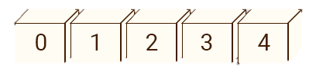
Model
Here the DenseNet201 architecture of keras TensorFlow, which is a pre-trained convolutional neural network (CNN) for image classification is used.
How DenseNet201 Works?
DenseNet201 is trained on large-scale datasets like ImageNet, making it capable of generalizing well to a variety of image recognition tasks. Its efficiency and accuracy make it particularly useful for applications on mobile devices, where computational resources may be limited.

Slide 16
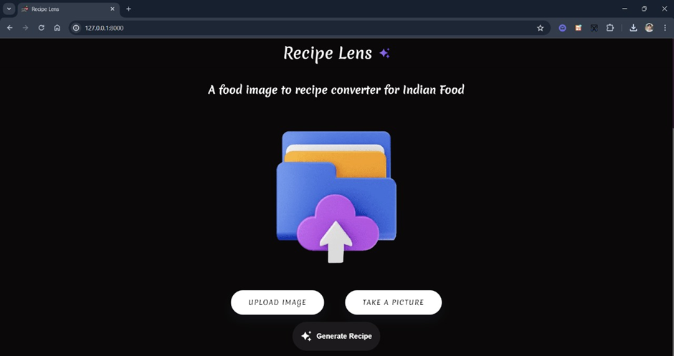
User interface
  Upload Image:
  Allows users to upload a food image from their device.
  Take a Picture:
  Enables users to capture a photo using their device camera.
  Generate Recipe:
  Centrally located to initiate the recipe generation process easily.

Slide 17
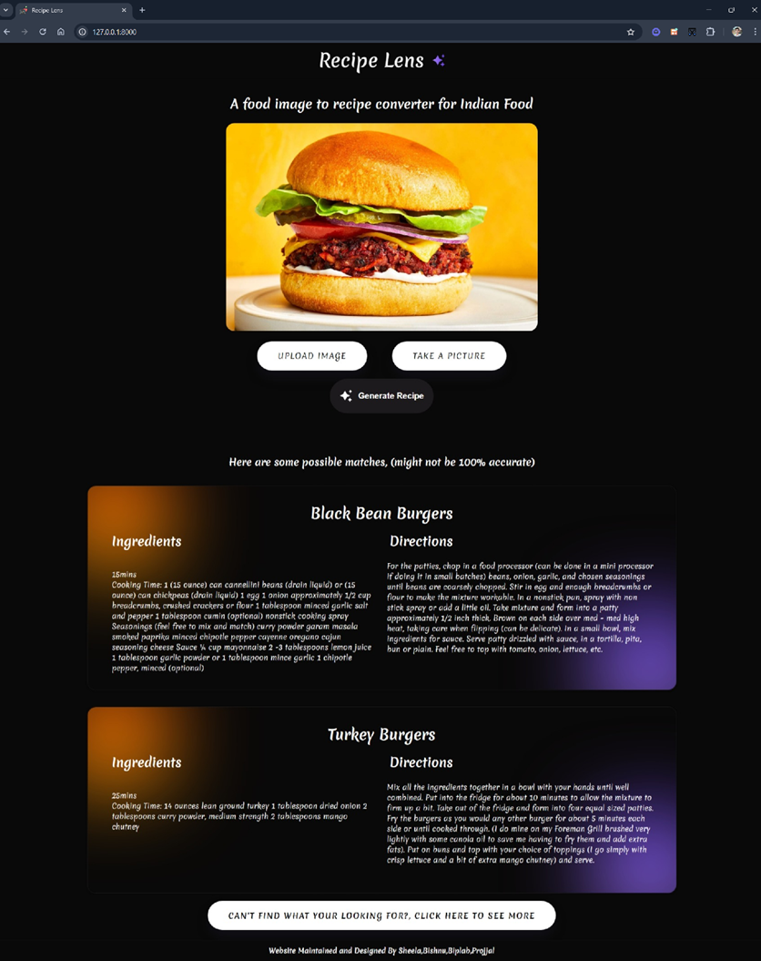
User interface
  Result:
  If recipes are returned, displays each recipe with its name, ingredients, cooking time, and directions.
  If users are not satisfied with the initial 10 results, they can click "Show More Recipes" to view additional recipes.

Slide 18

Future Scopes
Login Feature: Enhances user interaction with secure access.

Slide 19
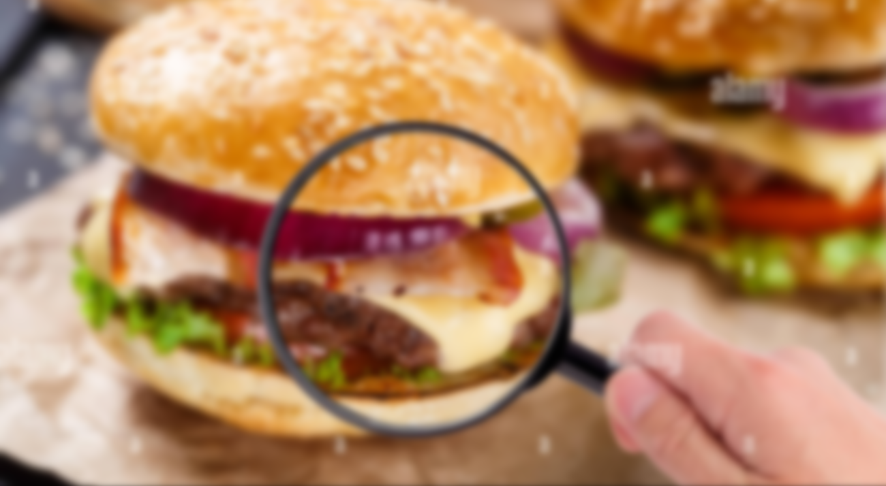
Thank You!

